Slide 1
Bucharest emulsion group along the time
Who we are

Slide 2
I share these thoughts
Milla Baldo Ceolin THE DISCREET CHARM OF THE NUCLEAR EMULSION ERA

Slide 4
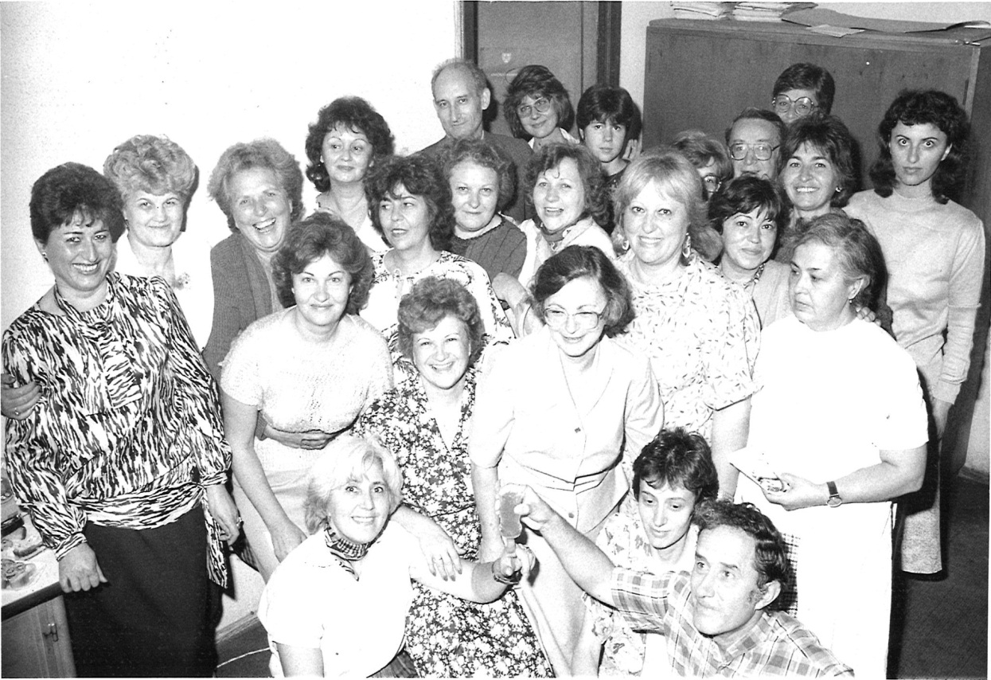
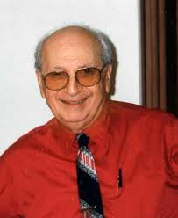
The laboratory of cosmic rays was one of the laboratories of the Institute of Atomic Physics , which was created in 1956
The team
E.M.Friedlander
(Head of the lab. from 1958-1975)

Slide 5
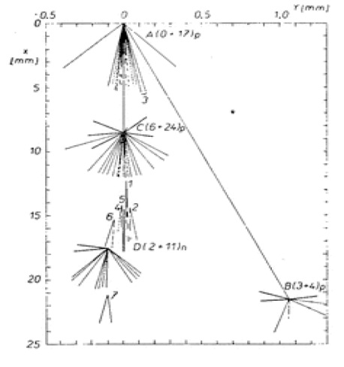
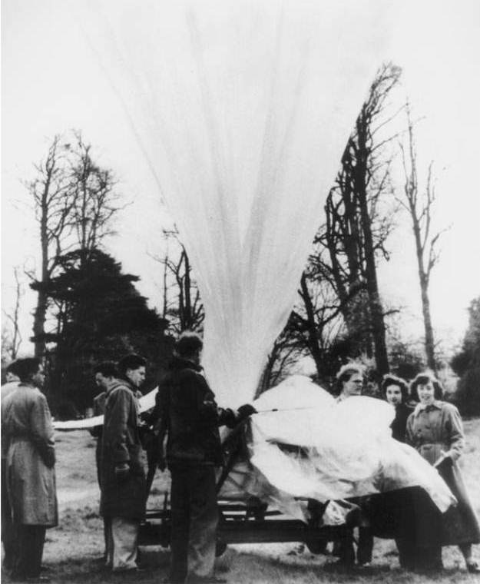
1956 - 1960 The first experiments were on emulsions flown on balloons
Tasks: Study of high energy nuclear interactions (collision mean free path, - anomalons- , trasverse momenta, angular distributions , models of interaction, study of secondary stars, etc.)
A baloon ready for the ascent in the Sardinia area, July 1953
For the first time emulsion stacks were made of stripped emulsions bound together between thick glass plates

Slide 6
1960-1970
Extended study of interactions of different nuclei from accelerators beams in nuclear emulsions
JINR - Syncrofazotron , protons of 9 GeV
CERN – PS, proton of 28 GeV
CERN – ISR, first hadron collider
FNAL - Tevatron, protons of 200 GeV, 300 GeV and 400 GeV
PROTVINO - Accelerator, protons of 70 GeV

Slide 7
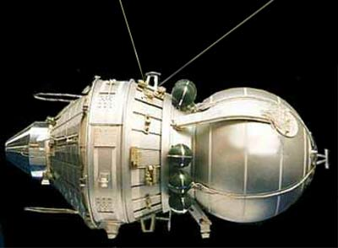
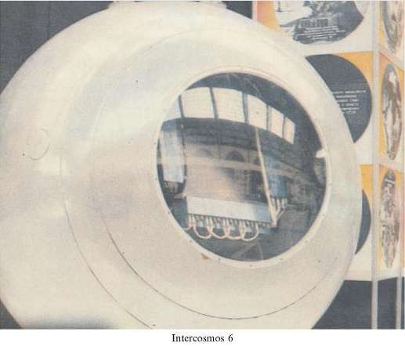
1970-1978 IK-6 Intercosmos satellite had a stack of 45 l emulsion on board
1, 4 track spark chambers 2 emulsion stack
3 horizontal emulsion sheets 5, 7 scintillators
6 Ionization calorimeter 8 PM
We scanned for mini electron positron showers and traced them back until we fond their origin - the interaction of nuclei. In five events selected for analysis, as a result of 67 interaction, we determined the mean multiplicity 3.3+-0.7. The energy of the primaries was evaluated as above 1 TeV.

Slide 8
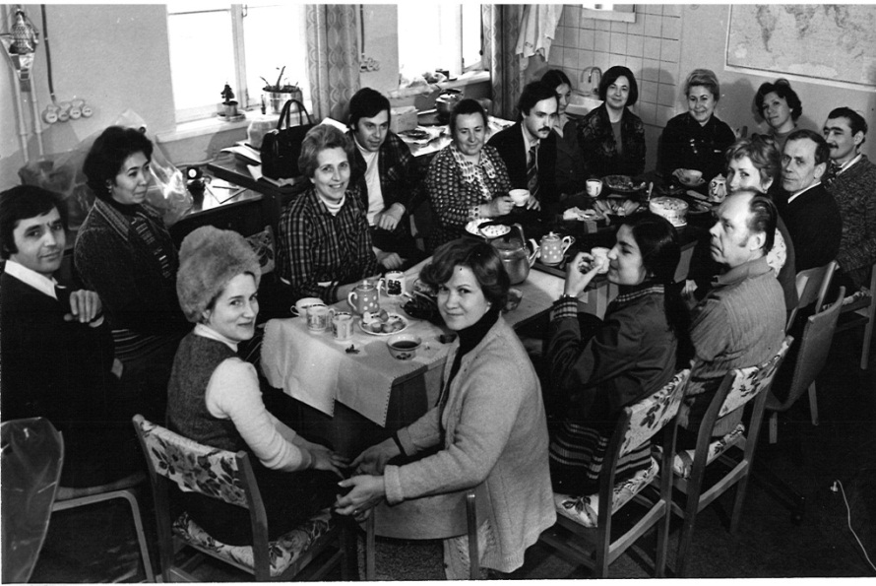
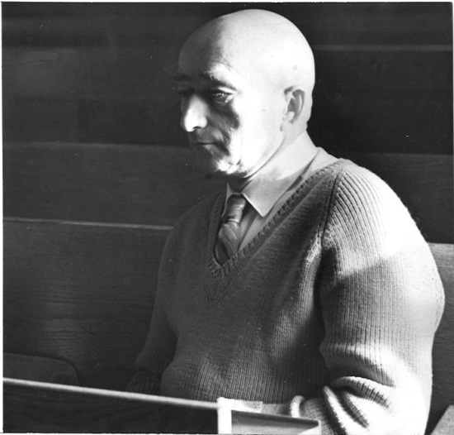
1975-1990 Collaboration of laboratories of nuclear emulsion members of JINR – Dubna
Inelastic interactions of 12-C nuclei with with nuclear emulsions at 50 GeV/c
Observation of a collective flow in22Ne collisions with Ag(Br) emulsion nuclei at 4.1 A GeV/c
Interaction mean free path in nuclear emulsion of fragments of 22Ne nuclei witn momentum 4.1 A GeV/c and the problem of anomalons
Fragmentation of ²²Ne in emulsion at 4.1A GeV/c
Some peculiarities of sideward flow of particles in ²²Ne collisions with emulsion nuclei at 4.1A GeV/c
Tea break K.D.Tolstov
head of the emulsion group of high energy laboratory JINR

Slide 9
Meeting of the Emulsion Committee JINR Picture taken in front of the International Conference Hall in Dubna

Slide 10
1990 - 2000 EMU-01 collaboration 100 scientists, 20 institutions and 12 countries
Complex Analysis of Au Interactions with Photo-Emulsion Nuclei at 10.7 GeV/nucleon within the framework of Cascade and Fritiof models
Angular distributions of light projectile fragments in deep inelastic Pb + Em interactions at 160 A GeV
Nuclear Effect in Higher Dimensional Factorial Moment Analysis of 16O-, 32S-, & 197Au-Em interaction data at 200, 60 and 11GeV/c
Limiting fragmentation in Oxygen Induced Emulsion Interactions at 14.6, 60 and 200 A GeV
Rapidity Densities and their Fluctuations in Central 200 A GeV S ³² Interactions with Ag,Br nuclei.
Helium Production in 10.7 A GeV Au Induced Nucleus-Nucleus Collisions
On the Production of Slow Particles in High Energy Heavy Ion Collisions
Rapidity density distribution in O16, Si28, Au197 and Pb208 induced heavy ion interactions at 4 -200 A GeV
Bounce-off in 197Au Induced Collisions with Ag(Br) Nuclei at 116 A GeV/c
Fragmentation and Multifragmentation of 10.6 A GeV Gold Nuclei

Slide 11
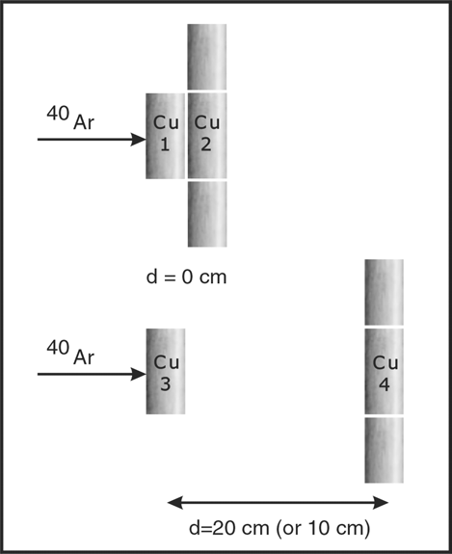
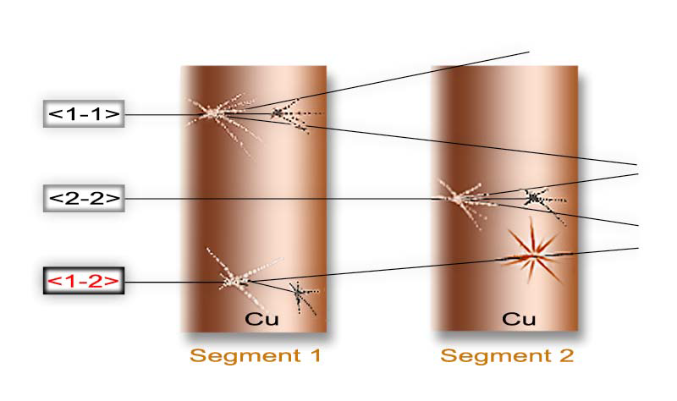
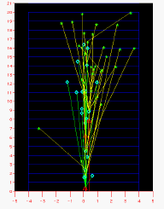
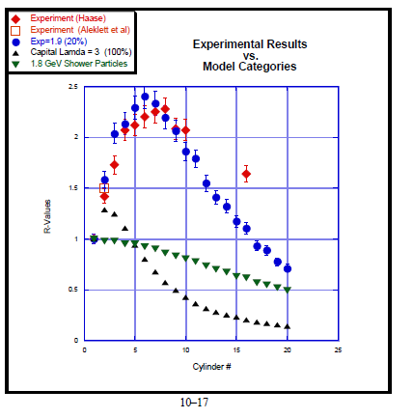
1995-2002 Project Cascade (ERAU – Florida, LBL-Berkeley, Philipps-University Marburg, ISS-Bucharest)
Scanning and measurement of an emulsion stack exposed to a 1.8 A GeV 40Ar beam from Lawrence Berkeley Laboratory’s Bevatron.
Modeling of a 1.8 A GeV 40Ar beam on cylindrically symmetric segments of Cu targets
Monte-Carlo simulations based on a transport code, itself built upon the results of the emulsions experiment.
1.8 A GeV 40Ar beam on a native copper target. 24Na-production provides an unusual and extremely useful form of calorimetery where the total amount of 24Na produced in a target segment is a direct
function of the cumulative (target) interactions with relativistic (projectile) primaries and secondaries.
Evaluation of R =ActivitySegment2/Activity Segment 1 in the experiment and in Monte Carlo simulations
Basic Experimental Setup
Cascade development in cylindrical target
R- values

Slide 12
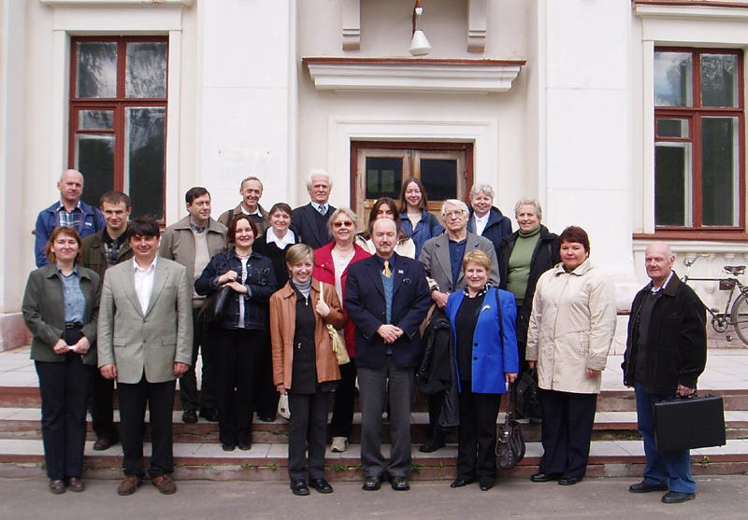
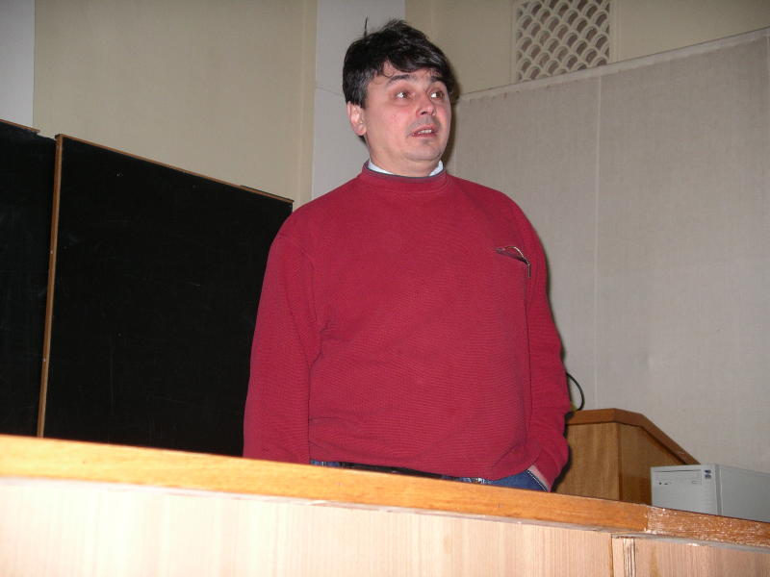
2002 - 2013 Becquerel Project JINR ( Dubna )
Irradiation of emulsions in beams of relativistic nuclei
Study of the processes of relativistic fragmentation of light radioactive and stable nuclei.
Investigation of light nuclei clustering in relativistic multifragmentation processes
Clustering in relativistic dissociation of different nuclei
The collaboration team at the
High Energy Laboratory - JINR
The leader
P.I.Zarubin

Slide 13
Institute of Space Science – Bucharest
The team

Slide 14
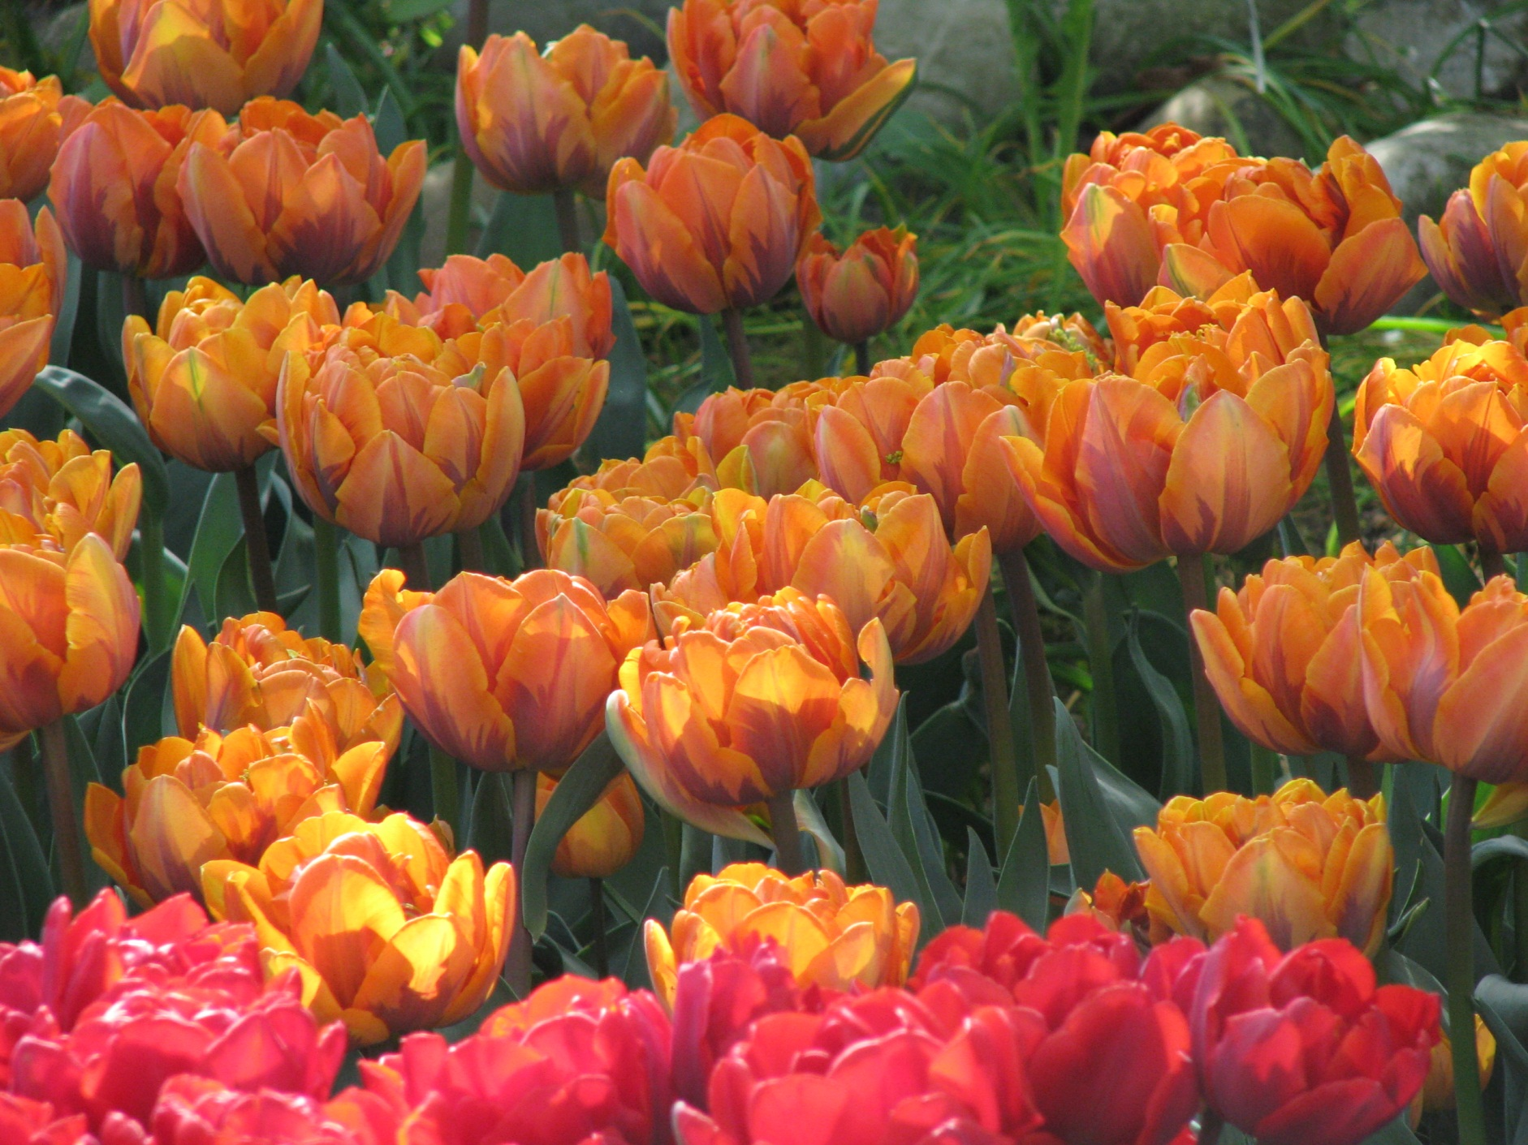
Thank you

